Slide 1
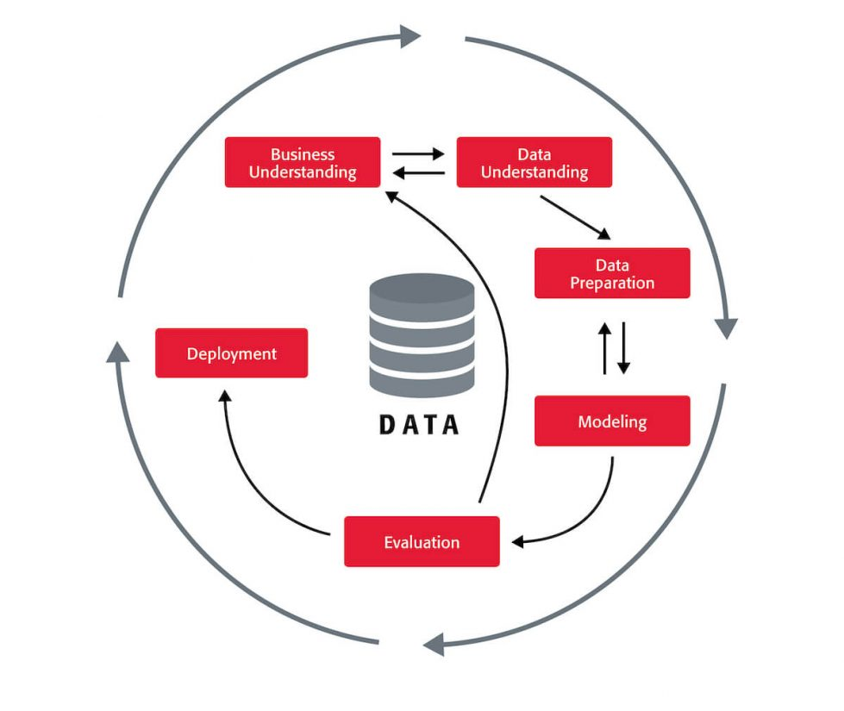

LOCAL DYNAMIC NEIGHBORHOOD-BASED OUTLIER DETECTION APPROACH AND ITS FRAMEWORK FOR LARGE-SCALE DATASETS
Guide Details
K RAJITHA (MTech)
Department of Computer Science
Team Details
SINDAM SAI KIRAN (20T81A0547)
ALLADA SUBRAMANYAM RAHUL (20T81A0562)
B YASHWANTH REDDY (20T81A0572)

Slide 2
INDEX
Abstract
Problem Definition
Motivation
Objectives
Existing System
Proposed System
Hardware Software Requirements
System Architecture
Technologies Used
System Implementation & Methodologies
Conclusion

Slide 3
ABSTRACT
Local outlier detection faces challenges in large datasets. Existing algorithms struggle with efficiency and adaptability to diverse data patterns. We propose a novel approach using Dynamic References Nearest Neighbors (DRNN) for robust neighborhood selection and combine it with k-means for efficient outlier detection. Our method outperforms classical methods in accuracy and robustness, while maintaining high efficiency on large-scale data. This marks a significant advance in local outlier detection.

Slide 4
PROBLEM DEFINITION
Develop a novel and robust outlier detection framework that addresses the limitations of existing methods and effectively identifies outliers in large-scale datasets while ensuring:
High accuracy in outlier detection, even with diverse data patterns.
Efficiency in terms of computational time and resource usage.
Robustness to variations in dataset characteristics and parameters.
Scalability to handle large datasets efficiently.

Slide 5
MOTIVATION
The hidden gems within massive datasets can be obscured by outliers, distorting analytics and hindering model performance. Traditional outlier detection methods often stumble in the face of such vast collections of data, yielding inaccurate results, being overly sensitive to parameter settings, and bogging down under computational weight. Driven by the desire to bridge these shortcomings, I embarked on a quest to craft a novel, robust solution for pinpointing outliers with both accuracy and efficiency.
By harnessing the adaptive power of Local Dynamic Neighborhoods (LDN), which offer data-driven neighbor selection for each point, I sought to build an outlier detection framework that would dynamically adjust to the unique patterns within each dataset. To ensure scalability and maintain high accuracy, I envisioned fusing LDN with the well-established k-means clustering algorithm. This project, ultimately, is a valiant step towards expanding the frontiers of large-scale outlier detection, aiming to deliver a powerful and versatile tool that empowers insightful data analysis.

Slide 6
OBJECTIVES
Forge a novel LDN (Local Dynamic Neighborhood) approach: This data-driven technique will dynamically adapt neighbor selection for each data point, unlike rigid traditional methods.
Conquer accuracy and efficiency: We aim to craft a framework that swiftly flags outliers with exceptional precision, even in the face of vast datasets.
Break free from parameter sensitivity: Traditional methods often buckle under sensitive settings. We'll strive for an LDN framework that gracefully navigates different parameters without sacrificing accuracy.
Unite LDN with the trusted k-means: By harnessing the strengths of both approaches, we seek to achieve both efficiency and high accuracy, even with large-scale datasets.
Push the boundaries of outlier detection: This project aspires to be a pivotal leap forward, empowering researchers and analysts with a robust tool for uncovering hidden gems within massive datasets.

Slide 7
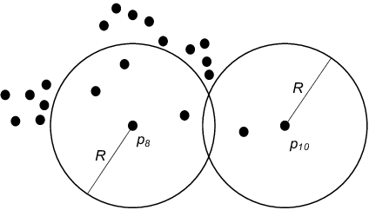
EXISTING SYSTEM
Accuracy vs. Efficiency: Existing methods often make trade-offs between accurate outlier detection and efficient computation, especially on large datasets.
Parameter Sensitivity: Many methods rely on carefully chosen parameters, such as neighborhood size or distance thresholds, making them less adaptable to diverse data.
Scalability: Traditional methods often have high time and space complexity, making them impractical for large-scale data analysis.
Distance-Based Outliers

Slide 8
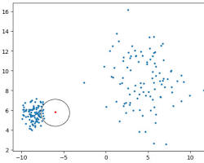
PROPOSED SYSTEM
Dynamically adapting neighborhood size: Instead of using fixed k-nearest neighbors (kNN), LDN defines neighbors based on local data density, providing better adaptability to complex structures.
Robustness to noise and incomplete data: LDN incorporates outlier influence and outlier probability calculations, making it more resistant to noise and missing values.
Highly efficient framework: Combining LDN with k-means clustering leverages the strengths of both approaches, achieving efficient outlier detection even on large datasets.
Density Based Outlier Detection

Slide 9
HARDWARE, SOFTWARE REQUIREMENTS
Hard Requirements :
System : Pentium IV 2.4 GHz.
Hard Disk : 40 GB.
Floppy Drive : 1.44 Mb.
Monitor : 15 VGA Color.
Mouse : Logitech.
Ram : 512 MB.
Software Requirements :
Operating system : Windows 8Professional.
Program plugins : python

Slide 10
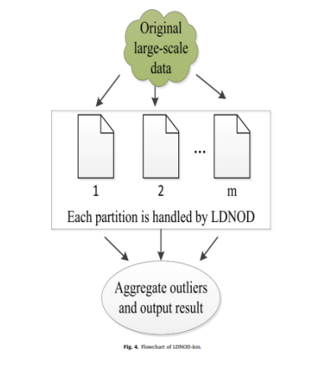
SYSTEM ARCHITECTURE

Slide 11
USED PYTHON LIBRARIES
TensorFlow
Numpy
Pandas
MatplotLib
Scikit-Learn

Slide 12
SYSTEM IMPLEMENTATION & METHODOLOGIES
1. Data Preprocessing:
Clean and normalize the data to prepare it for analysis.
2. LDN Algorithm Implementation:
Define the local density ratio threshold.
For each data point , Calculate the dynamic kNN based on the density ratio.
Compute the LOF score using the dynamic kNN. * Consider outlier influence and outlier probability.
3. Outlier Scoring and Thresholding:
Assign outlier scores to each data point based on the combined LOF, influence, and probability calculations. Apply a suitable threshold to identify outliers.
4. Evaluation and Refinement: Evaluate the performance of the LDN model on benchmark datasets or real-world applications. Fine-tune parameters and refine the algorithm as needed.

Slide 13
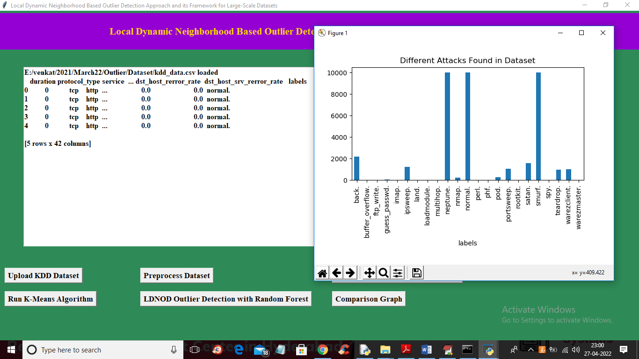
SCREEN-1
In above screen dataset loaded and displaying some values and dataset does not contains any cluster labels and after applying KMEANS will get cluster label. In above graph x-axis contains attack names and y-axis contains count of each attack found in dataset. In above screen dataset contains some non-numeric data so close above graph and then click on ‘Preprocess Dataset’ button to process data and get below output

Slide 14
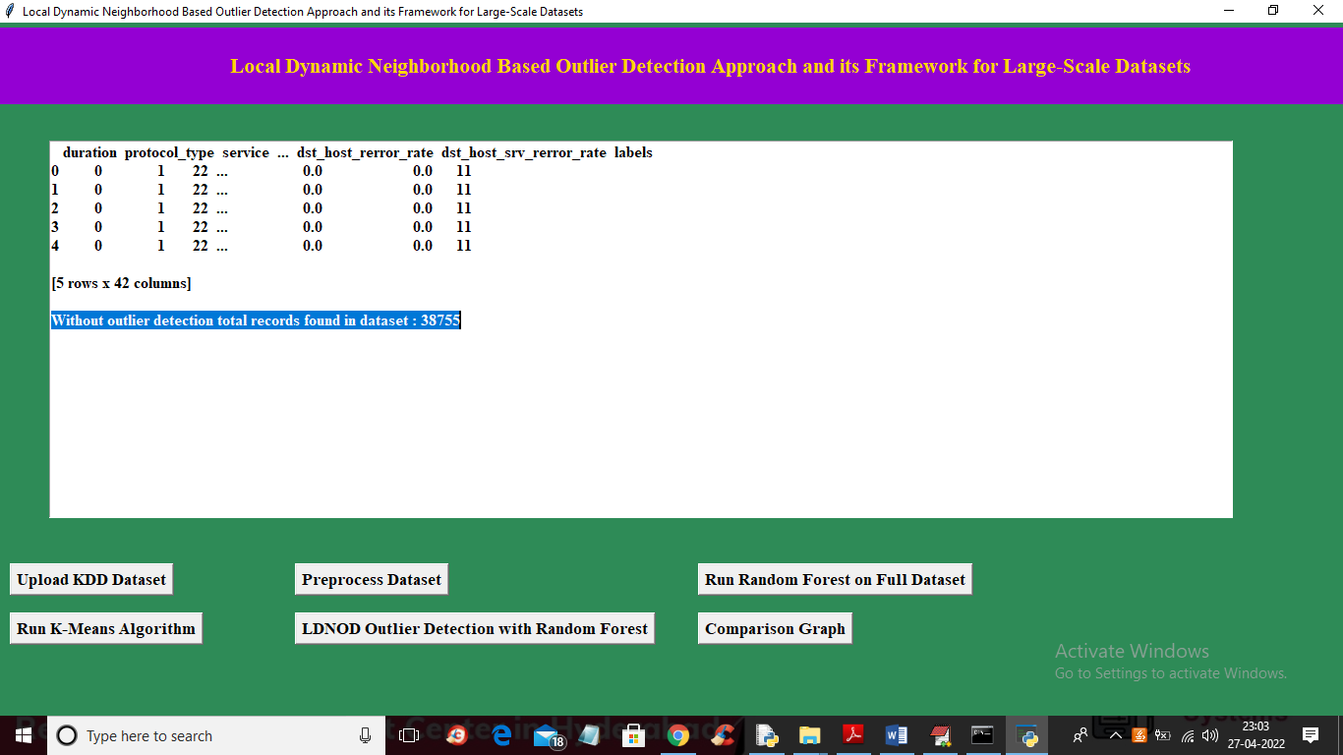
SCREEN-2
In above screen we can see all values are converted to numeric data and in blue line we can see dataset contains 38755 records without outlier detection and now click on ‘Run Random Forest on Full Dataset’ button to train Random Forest and get below output

Slide 15
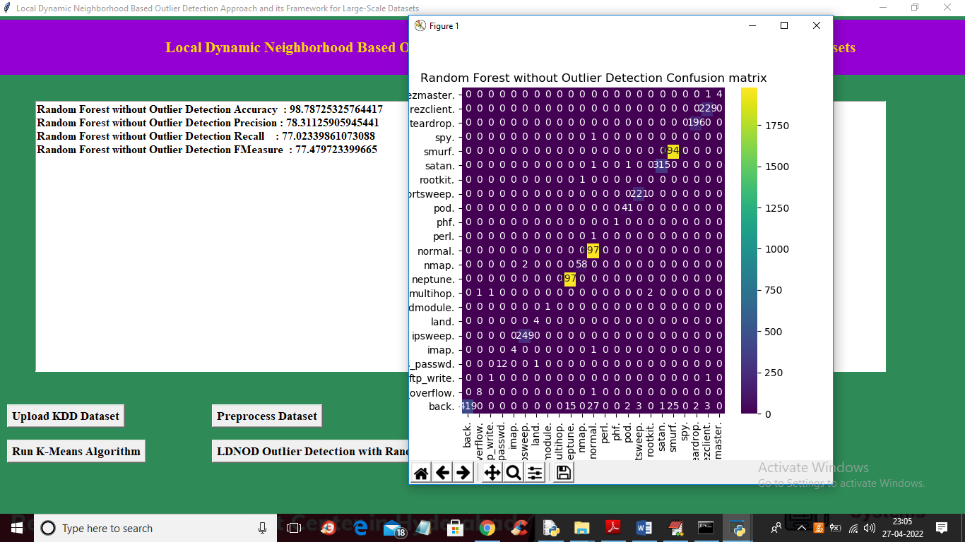
SCREEN-3
In above screen on full dataset with Random Forest we got 98% accuracy and in confusion matrix graph x-axis represents predicted attacks and y-axis represents TRUE test data attacks and in diagnol we can see both predicted and true labels are matching and now close above graph and then click on ‘Run K-Means Algorithm’ button to cluster entire dataset and get below output

Slide 16
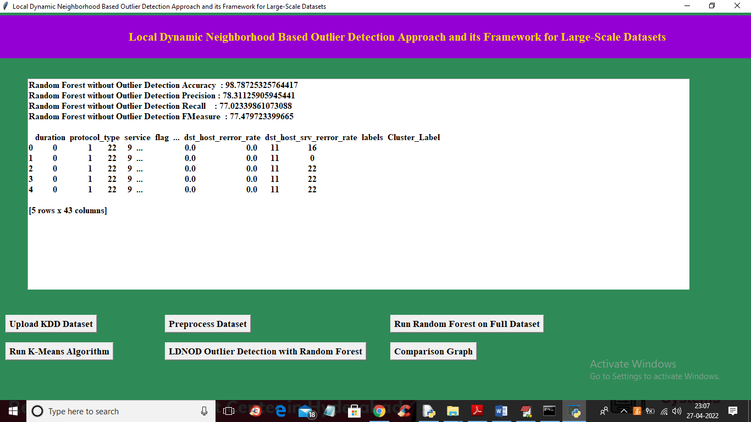
SCREEN -4
In above screen we can see cluster label added in last column and 16, 0, 22 are the cluster ID and now click on ‘LDNOD Outlier Detection with Random Forest’ button to apply LDNOD algorithm to compute similarity score between current record and neighbour records and if score is high then we will take that record and get below accuracy

Slide 17
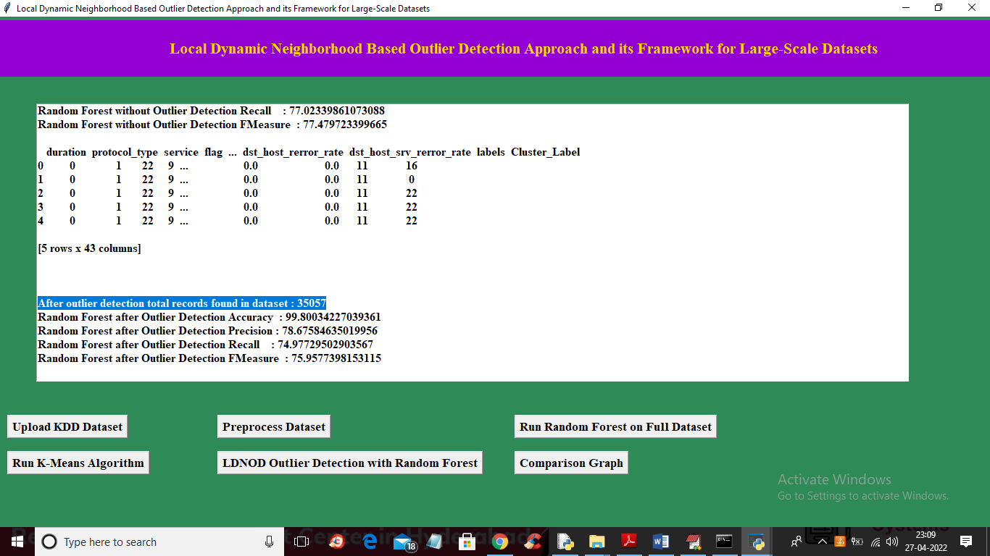
SCREEN-5
In above screen in blue colour text we can see after applying outlier dataset size reduced to 35000 from 38000 and after applying outlier we got accuracy with same random forest as 99.80 and below is the confusion matrix graph

Slide 18
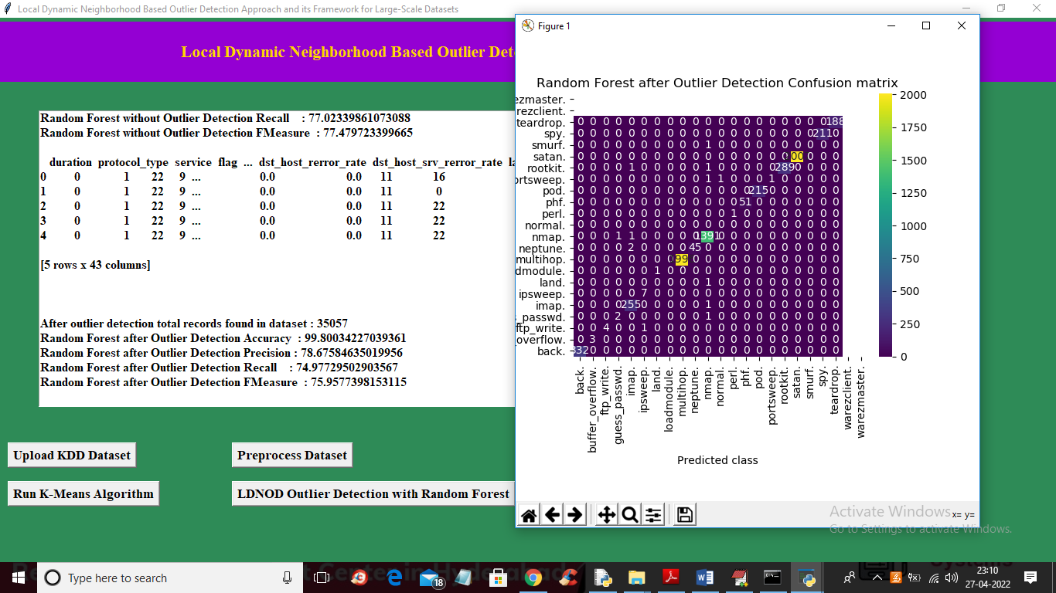
SCREEN-6
In above screen on full dataset with Random Forest we got 98% accuracy and in confusion matrix graph x-axis represents predicted attacks and y-axis represents TRUE test data attacks and in diagnol we can see both predicted and true labels are matching and now close above graph and then click on ‘Run K-Means Algorithm’ button to cluster entire dataset and get below output

Slide 19
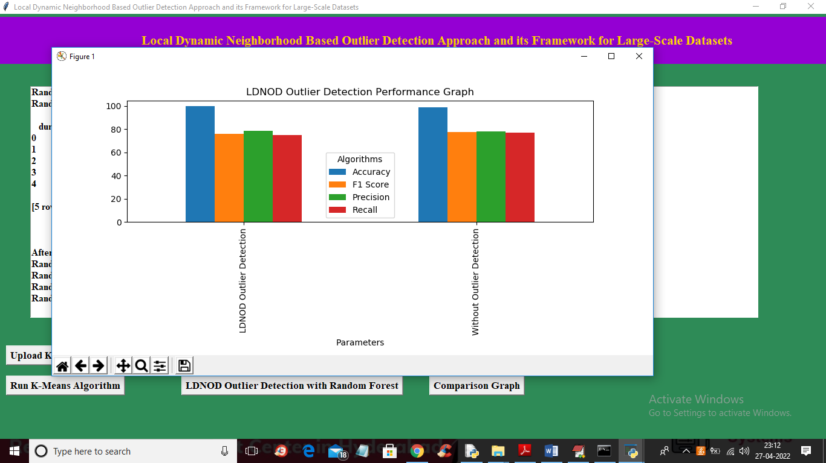
SCREEN-7
In the above graph x-axis represents technique name and y-axis represents accuracy and other metrics such as precision, recall and FSCORE with different colour bars and in both algorithm we got high accuracy after outlier detection.

Slide 20
CONCLUSION
In this paper, a new local detection algorithm (LDNOD) and its framework (LDNOD-km) have been proposed. The LDNOD is insensitive to neighborhood parameter due to the stability of DRNN, which constructs neighborhood of an instance based on dynamic reference objects. Moreover, sharing neighborhoods of close objects and scoring each local region are designed, which can potentially reduce the running time of LDNOD. Because the LDNOD-km combines the benefits of both LDNOD and k-means, it is able to handle large-scale datasets efficiently without sacrificing accuracy. Finally, experimental results have demonstrated the effectiveness of LDNOD and its framework. In the future, we will further improve LDNOD-km and apply it to handle larger scale and high dimensional datasets.

Slide 21
THANK YOU

